Slide 1
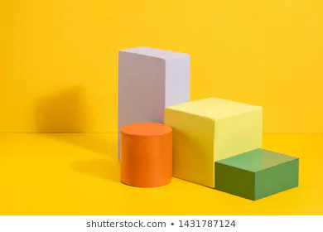
CLASS IX
CHAPTER 13
SURFACE AREAS AND VOLUMES
MODULE 1
Prepared by
Mrs. Saumia Nair
AECS-6,Mumbai

Slide 2
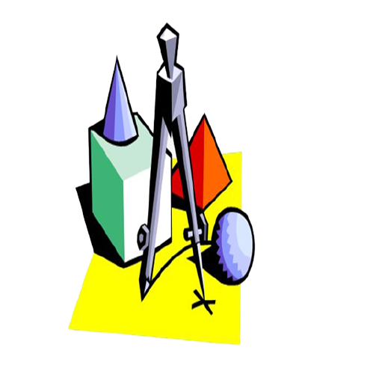
UNDERSTANDING SOLID SHAPES
They are three dimensional.
( length, breadth, height )
Some are made of polygons
Some are not made of polygons

Slide 3
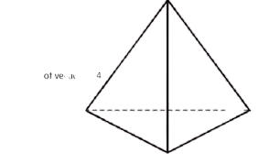
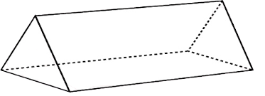
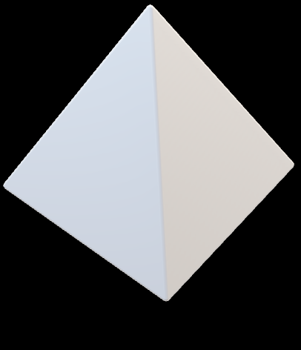

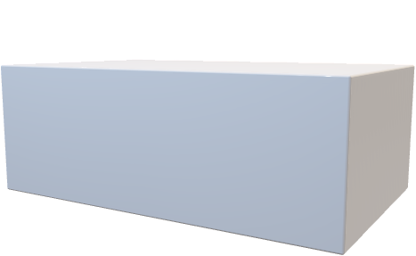
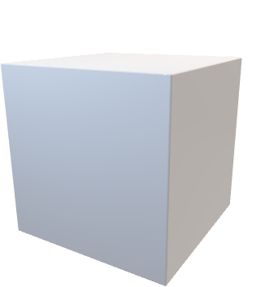
SOLID SHAPES MADE OF POLYGONS
Go back

Slide 4
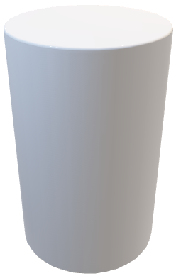

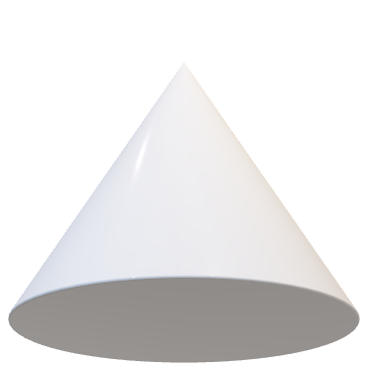
SOLID SHAPES NOT MADE OF POLYGONS

Slide 5
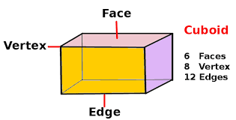
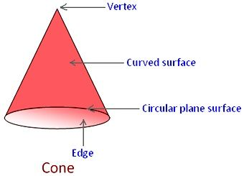
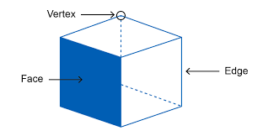
PARTS OF SOLID FIGURES
FACES – the surfaces
EDGES – line segments where two faces meet
VERTICES – points at which edges meet
Cube

Slide 6
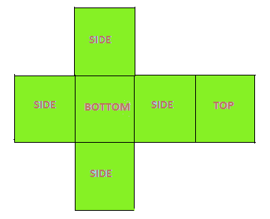
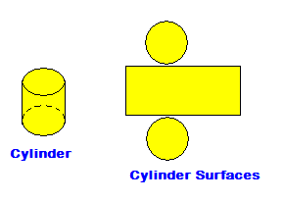
SURFACE AREA OF A SOLID FIGURE
The sum of the areas of all the faces of a solid figure is called as its surface area.
It is measured in square units.

Slide 7
VOLUME OF SOLID FIGURES
It is a measure of
how much space it occupies or
how much matter it can hold
It is measured in cubic units.

Slide 8

Thank you
Notes:
Thank you!!!!!!!!!!!!!!!!!

